Slide 1
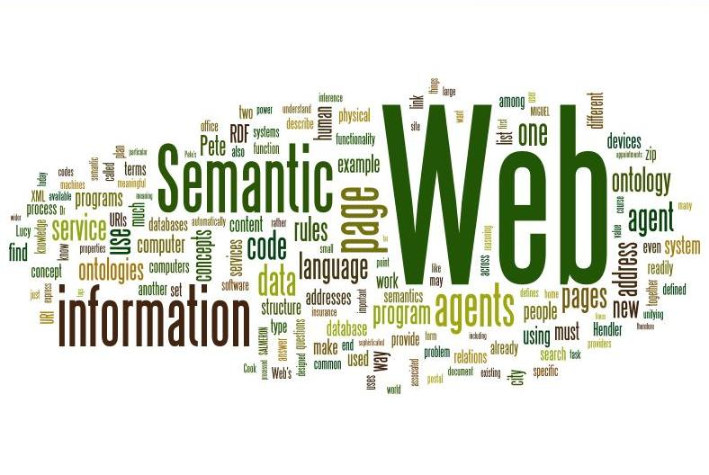
Summer of Vocabs: Knowledge Organisation
Water Resources Management - Environmental Information Infrastructures
Megan Williams| Vacation Scholar
29 January 2015
Land and Water Flagship
Notes:
Thanks for having me
And welcome everyone back to the 1st tech session of the Year
I will be presenting on the summer of vocabs project which has been underway over the past few months
Specifically I will be talking about what I’ve learnt about knowledge organisation and how I have been contributing to it./

Slide 2
Contents
Introduction
Vocabularies and the Semantic web
Formalization Process
How content becomes available
Reflections at CSIRO

Slide 3
Introduction

Slide 4
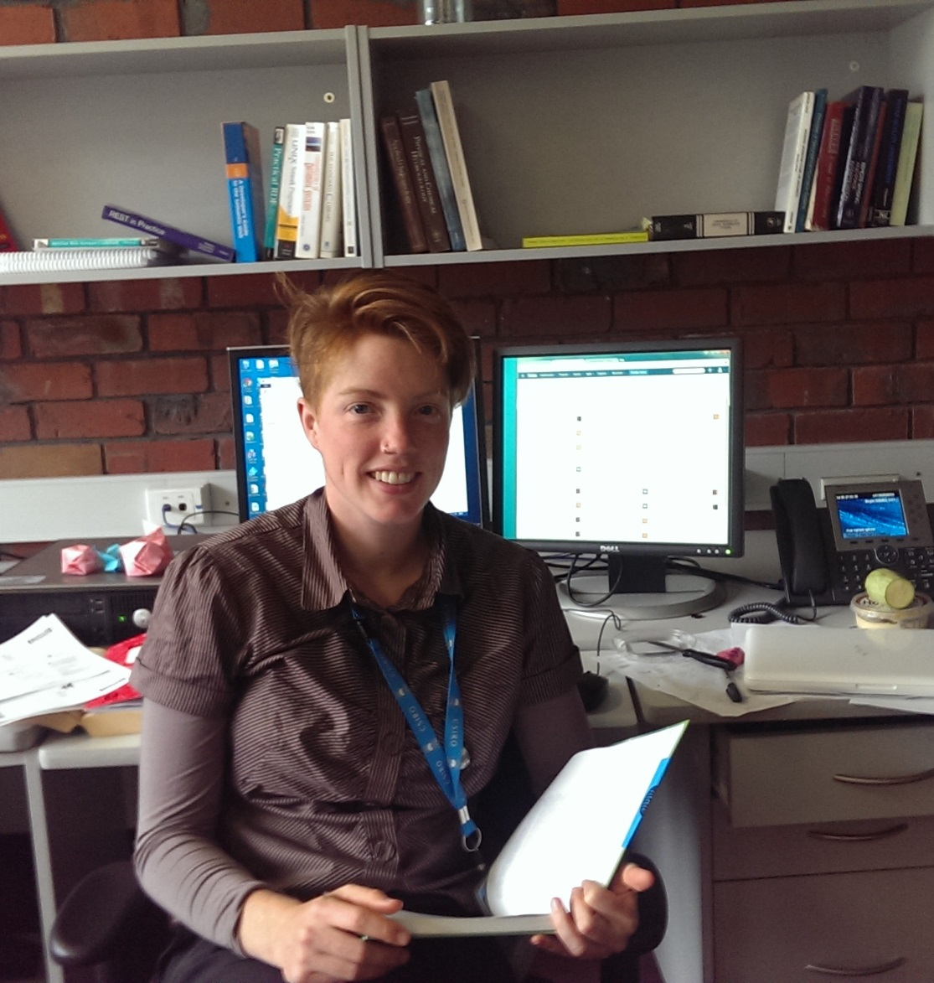
Who am I?
4th year RMIT student
Environmental Science/Social Science
Citizen Science
Future directions / Career in Environmental Science
Summer of Vocabs| Megan Williams
Notes:
1. Introduction
a. Who am I?
RMIT student, environmental science, social science.
Development for a sustainable future (renewables)
Interests, future goals, ambitions

Slide 5
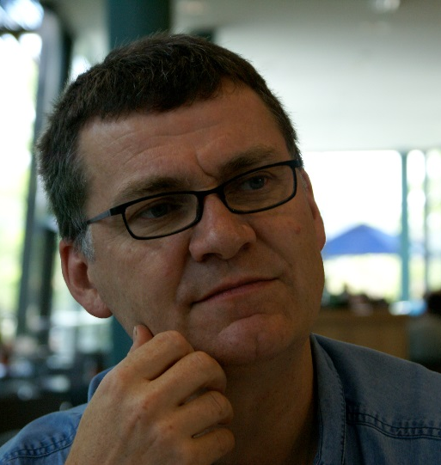
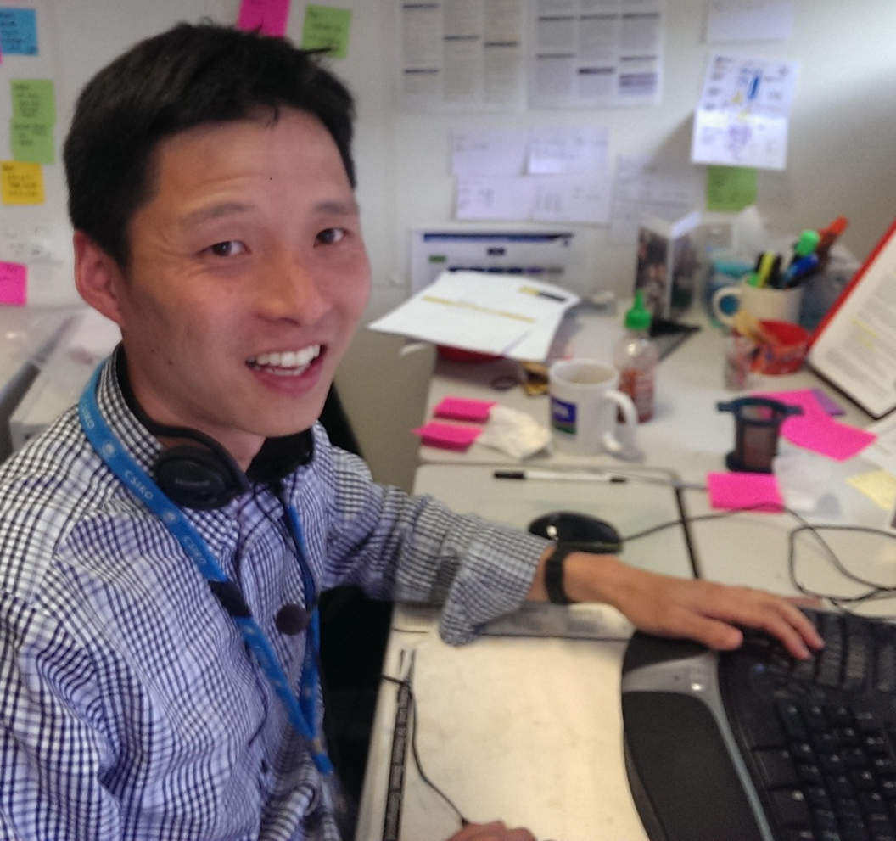
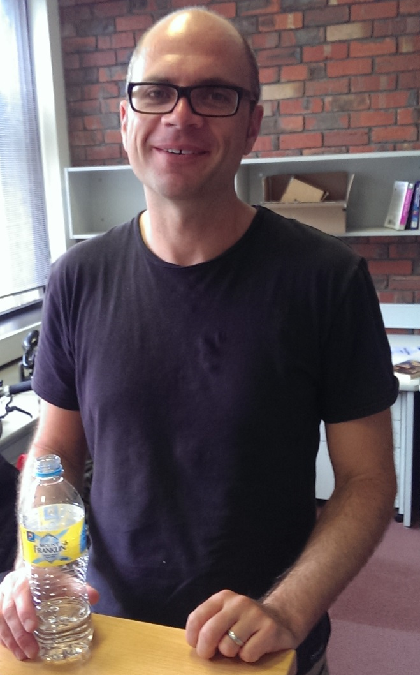

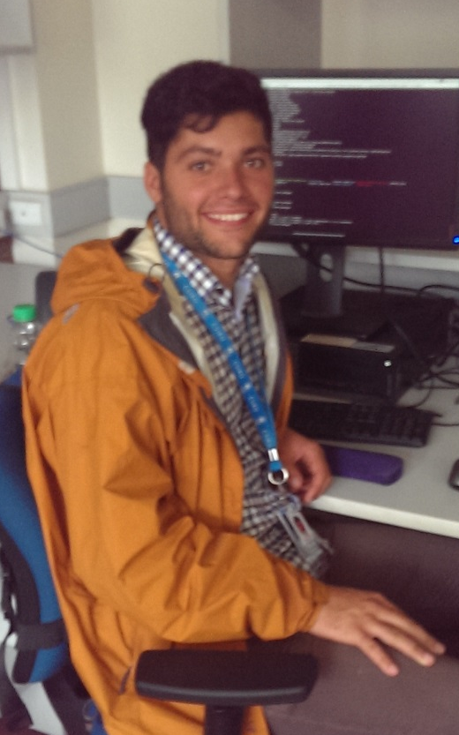
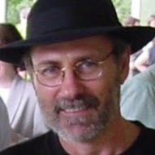
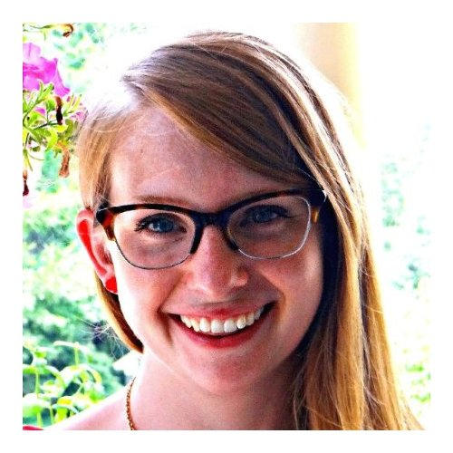
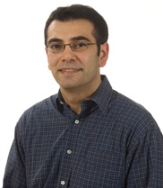
Place within CSIRO
Working with Simon Cox and the Environmental informatics team at Highett.
Finding and Formalizing content for the Semantic web
Summer of Vocabs| Megan Williams
Notes:
b. Context for work at CSIRO
Define my place at CSIRO L&W, Vocabularies, Highett, Simon Cox
Team working with vocabularies, semantic web technologies and linked data
Introduced to a whole new world of data management, structured methods for knowledge organisation, and new technology
Work based around finding and formalizing new content

Slide 6
Vocabularies and the semantic web

Slide 7
What is the semantic web?
How does it differ from the world wide web ?
Benefits and Users
Adds depth to web frameworks
Uses machine readable formatting
W3C standards RDF, SPARQL, SKOS
Turns the web into a global database
Increases usability of data across scientific fields
Interoperability
Summer of Vocabs| Megan Williams
Notes:
Semantic web is an additional web framework that add depth to content on the internet
Relies on every item having a unique and persistent URI
Requires formalized metadata schema’s
This is used to convert human readable data into a machine readable format
following the W3C Standards, RDF frameworks, Spaql query language, and SKO formatting
This improves the exchange of information
Increases scientific quality of research
Creates starting Point for building consistency amongst language used by organisations and disciplines
Essentially it turns the web into one giant data base
This allows user and computer to interact in a way that currently the web doesn’t.
This integration of data provides a service where the machine can conduct meaningful searches, which will provide more informed results
Main role
I have been working on developing pipelines for converting data in this form into an RDF format for upload onto the web

Slide 8
Vocabularies
A lists of terms, preferably with definitions
Governed by a recognized authority, and adopted by a relevant community
Accessible
Summer of Vocabs| Megan Williams
Notes:
So,
Which have come in many varieties, but as a minimum, they are a list of terms that preferably have definitions and sometime additional metadata.
This vocabulary must be maintained by an external authority, We on the vocabularies team focus on organizing the data, not on creating content. That is the responsibility of the recognized authority.
This authority should describe the vocabulary as it is used by the relevant community, and it must be openly accessible

Slide 9
Is a ‘term’ enough? - Beer glasses in Australia
Glass Size | 115 ml 4 oz | 140 ml 5 oz | 170 ml 6 oz | 200 ml 7 oz | 225 ml 8 oz | 255 ml 9 oz | 285 ml 10 oz | 425 ml 15 oz | 575 ml 20 oz
NSW | - | Pony | - | Seven | - | - | Middy | Schooner | Pint
NT | - | - | - | Seven | - | - | Handle | Schooner | -
QLD | - | Small Beer | - | - | Glass | - | Pot | - | -
SA | - | Pony | - | Butcher | - | - | Schooner | Pint | -
TAS | Small Beer | - | A Beer or Six | - | Eight | - | Ten or Pot | - | -
VIC | - | Pony | Small | Glass | - | - | Pot | Schooner | -
WA | Shetland Pony | Pony | Bobbie | Glass | - | - | Middy | Schooner | Pot
Source: http://www.liquormerchants.org.au/Q&A.html
9 |
Notes:
So this is an example of a vocabulary that .
As you can see it is dearly in need of formalization
It shows the inconsistent language used across Australia when ordering yourself a beer.
You can see that an uninformed Victorian visiting Tassie might be a little disappointed when ordering a small beer as they'd receive 60ml less than expected.
Conversely that same Victorian might find themselves struggling to stay under .05 after having 2 pots in WA
This highlight the benefits of creating and maintaining standard vocabularies

Slide 10
Simplified Knowledge Organization System SKOS: a W3C Standard
Focus on the concept rather than the term
Web/Linked data principle: Concept is identified by a URI
Concept is annotated with text labels (i.e. the traditional ‘term’)
Structured using hierarchical relations within a vocabulary
broader, narrower
Matching relations between vocabularies
broadMatch, closeMatch, exactMatch
Notes:
I’ve been building vocabularies predominantly using skos formatting
SKOS stands for:
Skos is a common data model that is define by the W3C standards
It work on a premise that terms are only employed as descriptors to concepts, which are themselves identified by URI’s
i
Each vocabulary is populated with a number of concepts – anything between a few dozen to well over a thousand.
Labels are used to annotate each concept and record metadata,and then Skos allows you to build relationships between terms within the vocabulary, and map to concepts from other skos vocabularies that are similar or exactly the same.

Slide 11
A ‘concept’ in a vocabulary
http://chemistry.example.org/Sulphate
http://vocabs.auscope.org/nvcl/0.4/SWIR
skos:broadMatch
skos:inScheme
skos:broader
“Sulphates”@en
http://vocabs.auscope.org/nvcl/0.4/NVCL
skos:narrower
skos:prefLabel
skos:inScheme
“Sulfate”@de
http://vocabs.auscope.org/nvcl/0.4/Sulphates
skos:prefLabel
rdf:type
skos:inScheme
skos:narrower
skos:notation
rdf:type
“SO₄”
rdf:type
http://vocabs.auscope.org/nvcl/0.4/Alunite
skos:Concept
rdfs:isDefinedBy
http://defs.auscope.org/Sulphates.html
Notes:
So, This is a rather complex example of the connectivity created when creating a skos vocabulary.
You can see that all the concepts are written using a URI * point to URI
We’ll focus on this one in red – Sulfates
You can see that it’s preferred label in English is

Slide 12
The formalization Process

Slide 13
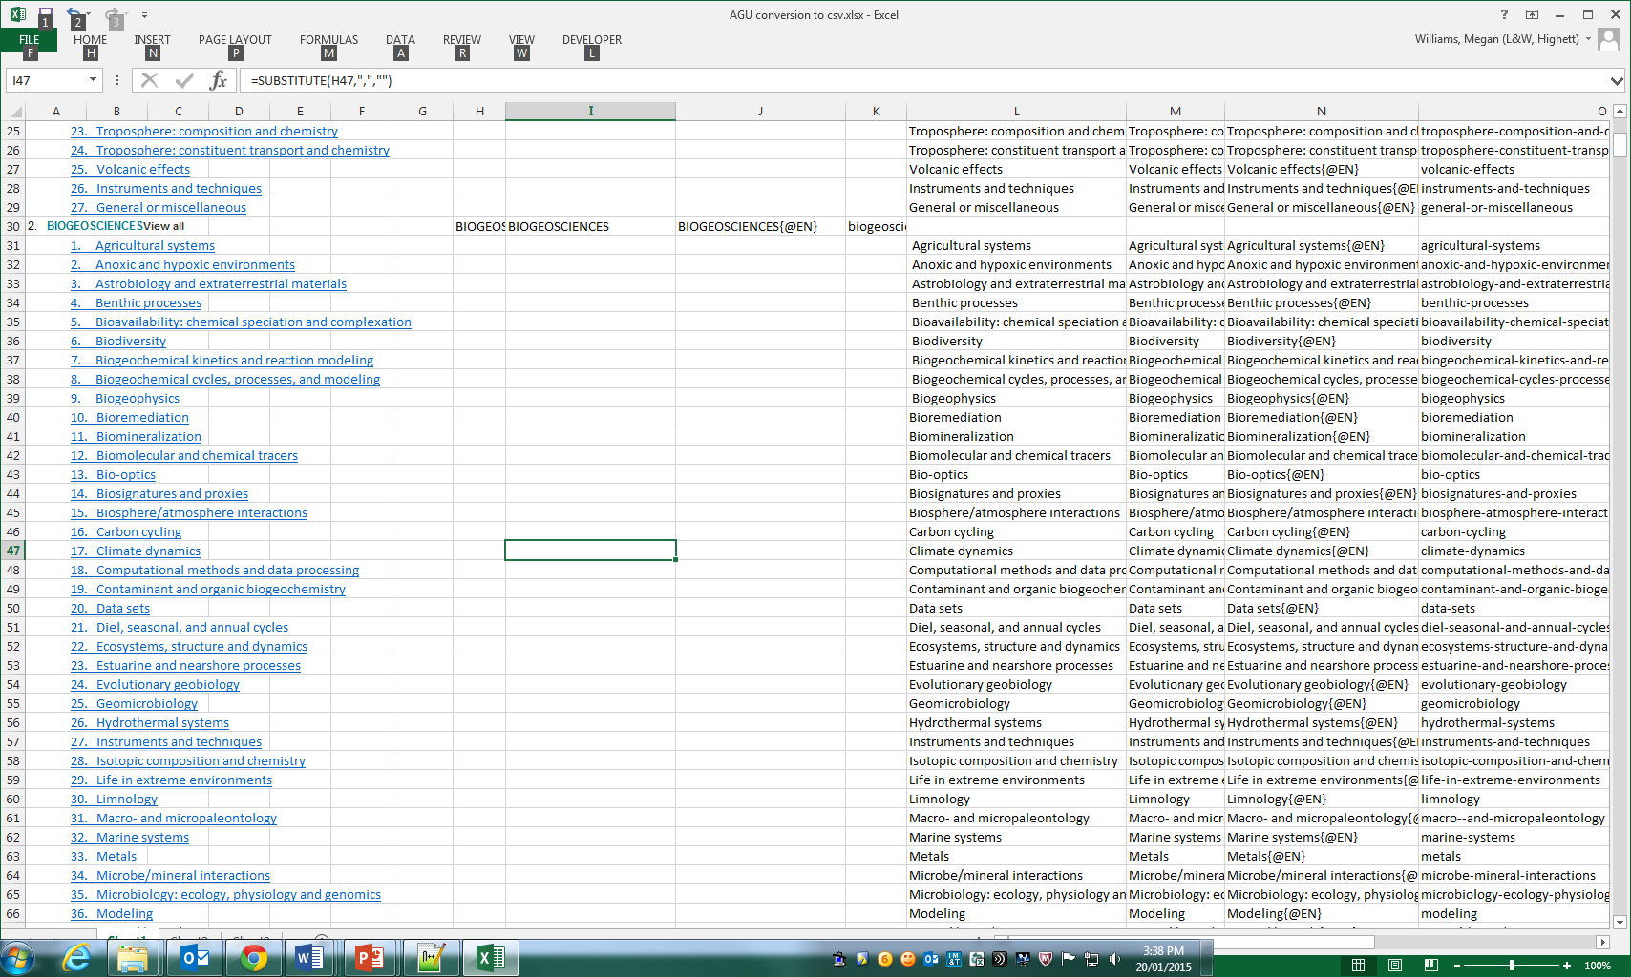
Formalization Process
Create order within existing excel spreadsheets
Notes:
Vocabularies are retrieved from various authorities, such as Bureau of Meteorology, National archives, ABS
Generally I have been focussing on vocabularies that are maintained in an Excel spreadsheet, and hosted online with no machine-readable information
1st step is to order the information contained in the spreadsheet in a way that I can use it
Start with Excel spreadsheet, where single columns often contain multiple pieces of information
Break this information out so that each column only contains a single property
Show with animations

Slide 14
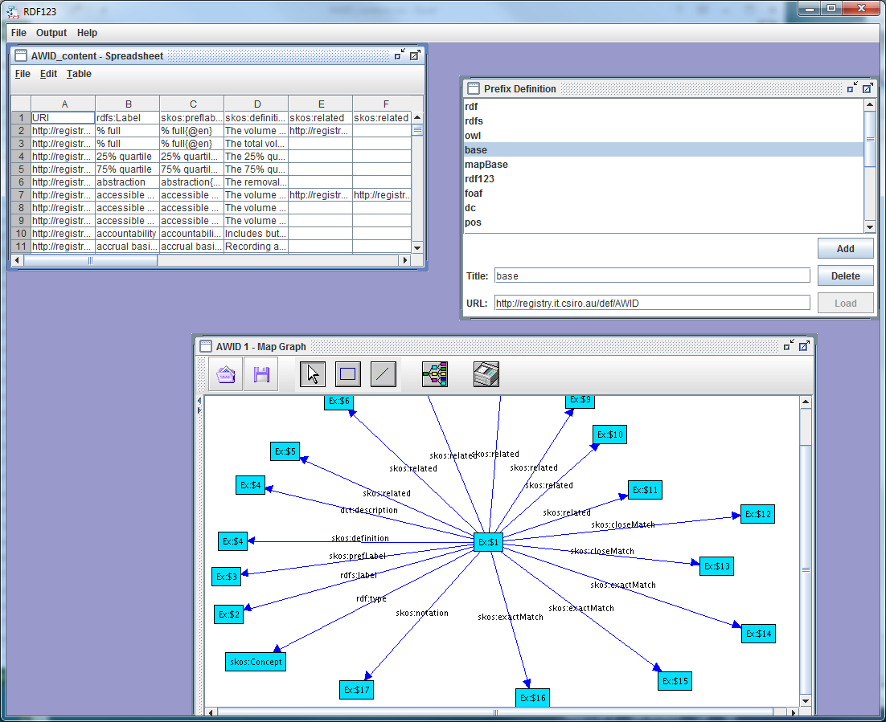
Formalization Process
RDF 123
Notes:
Step 2. Insert CSV to RDF 123
This program encodes the spreadsheet into an RDF format.
To do this I have to tell it some basic information
Import the spreadsheet, create relationships between the columns using the graph
Provide it with the prefixs it will use
* Use animations to make it clear

Slide 15
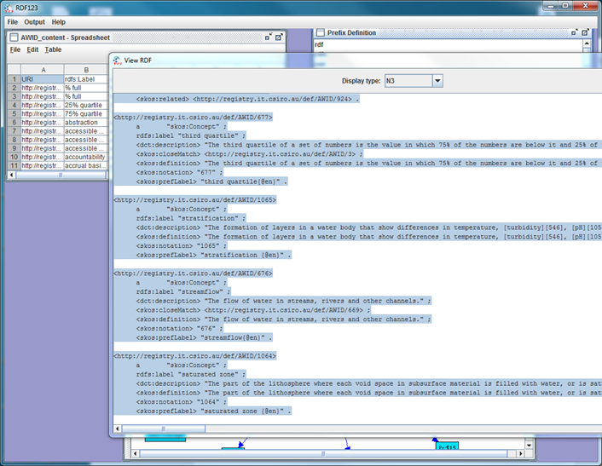
Formalization Process
RDF 123
Notes:
The Output
From here it takes some minor touching up using a text editor and/or RDF editor
and is ready to publish online

Slide 16
Applications

Slide 17
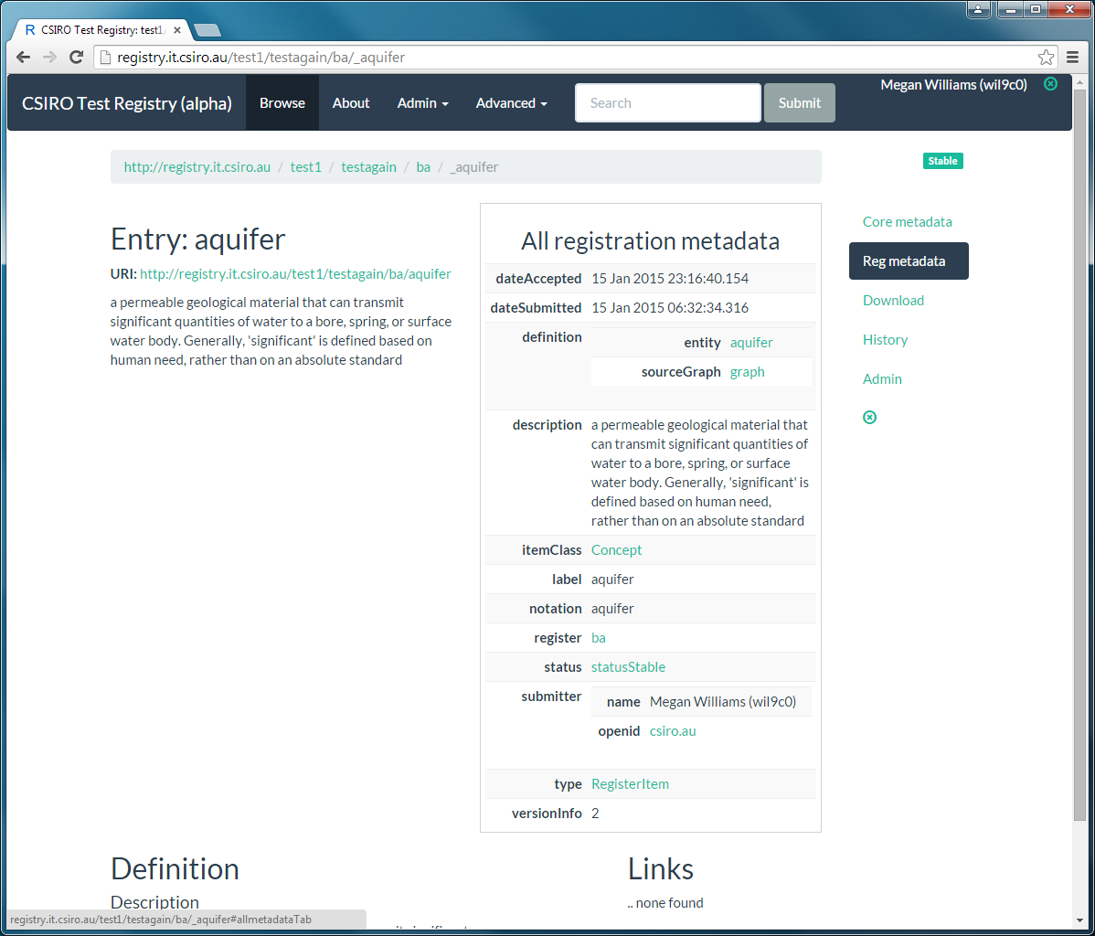
Publishing Vocabularies
AGIFT
AGU
ANZSRC
NGIS
AWID
BA glossary
Notes:
We publish the link data through an online vocabulary service,
Here: Link Data Registry
To be used for developing products and contributed to by (some) users
Example Bioregional assessments on the next page
AGIFT – Australian government interactive functions thesaurus
AGU – American geophysical Union index of terms
ANZSRC – Aus NZ Standard research Classifications
NGIS – National Groundwater Information System
AWID – Australian Water Information Dictionary
Bioregional Assessments
--------------------------
4. The products - Uploading to Registry
After all of this the products are ready to be put up online
WE’ve loaded into the link data registry
By developing and following this process Ive been able to formalize a number of vocabularies
Agift, ANZSRC, AGU, NGIS, AWID
This content then becomes available on the linkdata registry
Walk through the use of the registry and the benefits of it.
The processes for getting vocabularies to this stage are all documented, (or will be) and I have worked with Jane Frazier from ANDS to develop instuctions and basic resources for other people to follow.

Slide 18
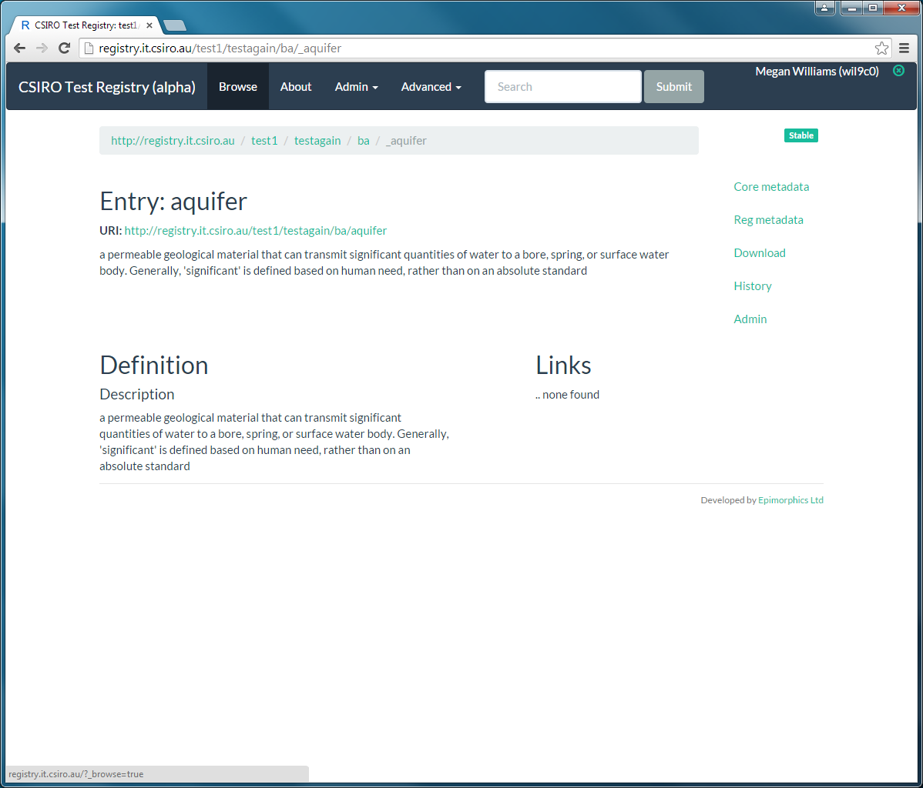
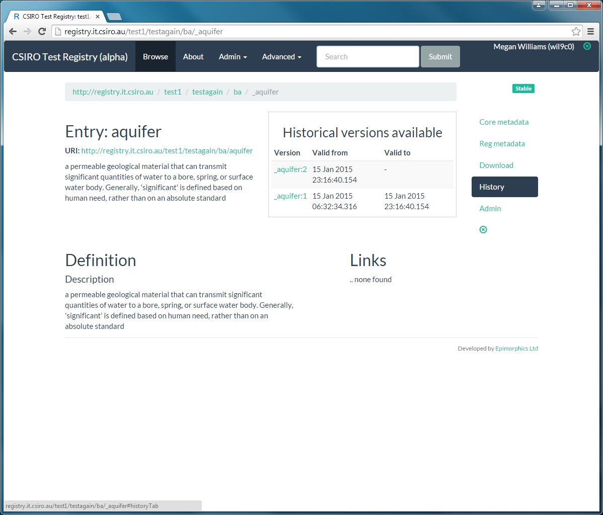
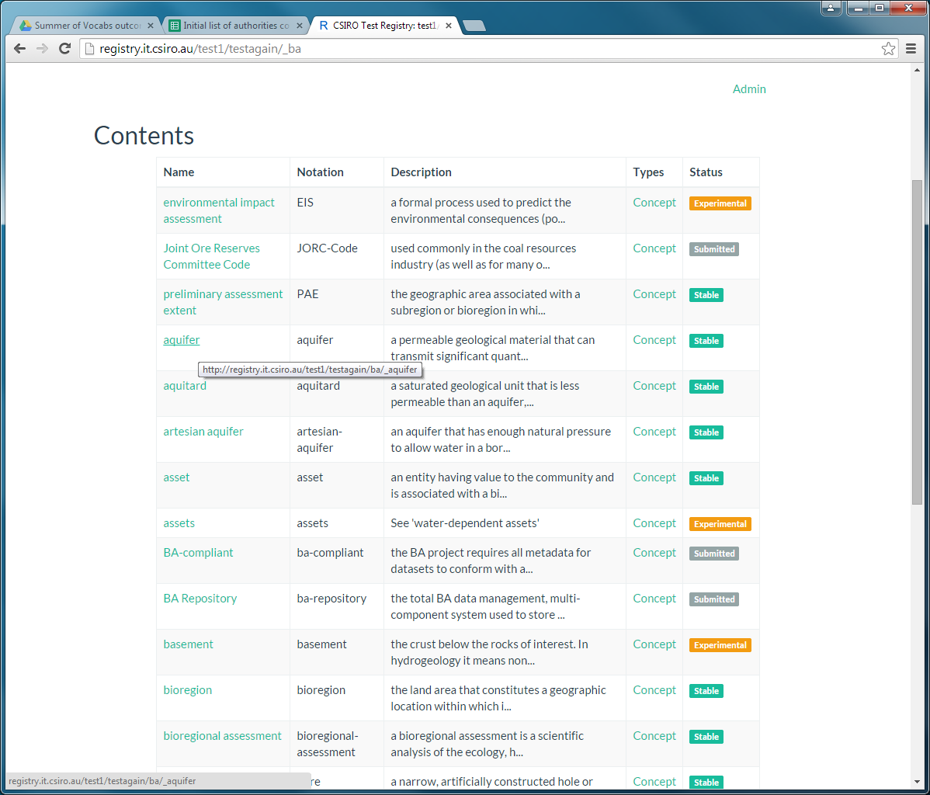
Applications: Bioregional Assessments
Notes:
The Bioregional assessments is a large project assessing potential impacts of large coal and coal seam gas. Using the skills I’ve learned over my time here I’ve helped assemble to an initial glossary and list of authorities that will be used as a resource for developing the glossary.
Also a good display of registry
Display list of concepts, acronyms, description and status
* click on aquifer
This shows the Term in more detail, and you can choose from the side bar to see additional information
* click on history
* Click on reg metadata

Slide 19
Applications: AGIFT
Used mapping to equate AGIFT to UN functions of Government (COFOG)
Easily identify and amend discrepancies between updates
Notes:
Australian Government Interactive Functions Thesaurus
The best example of how linked data has multiple benefits
I was able to map between the AGIFT and the COFOG the Equivalent vocabulary already available from the United Nations
(Classifications of the functions of government)
By formalizing the vocabularies I was able to easily identify discrepancies between updates. The AGIFT had a couple of inconsistencies which I pick up on, reported them to the National archives, and then I was able to amend them and return the file in a more versatile form without the issues.

Slide 20
Reflections

Slide 21
Reflections
What I’ve Learned
What I’m grateful for
Existence of Semantic web
Benefits of well maintained vocabulary services
New computer skill
Gained insight to the world of computer science
An appreciation of the complexity behind large projects
The opportunity to work with CSIRO before finishing my undergrad
Insight into the research career
Chance to contribute quality science
Time and generosity from everyone I’ve worked with
Notes:
Learned:
Existence of Semantic Web
As a developing area that hold great potential for science and research the appreciation of the benefits of well maintained vocabulary is something I will certainly take forward with me.
Opened my eyes to better ways of organising information.
I’ve learned a wide variety of new computer skills from applications like topbraid, to using text editors. An introduction to querying in SPARQL and use of of regular expressions. Has gput a spotlight on the depth of computer science. I’m no longer confined to the limitations of Microsoft office applications
Being involved in such a large collaborative project like the BA has given me an appreciation of the
Grateful:
Particularly grateful for the opportunity to work with all the wonderful people at CSIRO,
Chance to contriubute to Quality Science
-It has been very exciting to contribute to work that get the CSIRO stamp of approval, particularly as over the past past few years I’ve poured a lot of time and energy into projects that will eventually be lost to the depths of my hard drive – so to contribute to something that will get a CSIRO stamp and head out into the big wide world has been very exciting.
Last but not least I would like to thank everyone for the time and generosity that I’ve been shown
I have really learnt a lot and I really appriciate everything that Ive been given.

Slide 22
Thank you
Water Resources Management/Environmental Information Infrastructures
Megan Williams Vacation Scholar
t +61 3 9252 6004
e megan.williams@csiro.au
w www.csiro.au
Land And Water FLagship

